Slide 1
saving Electricity
Team Members:
1) Rania Kamel 2) Dolagy Baky
3) Ishak Saad 4) Kerolos Nady
5) Kerolos Romany 6) Saher Adel 2016

Slide 2
1)What is the scope of your program ?
1- The application will show the user the status of all devices(On or Off).
2- It show the user with the most electricity consuming devices and suggests to turn it off.
3- It sends a notifications to the user if there are a device still turned on along time (like chargers), and the user can allow access to turn it off automatically.
4- It provide the user with a report (daily, weakly, or monthly) of the Consumption of each device to help him to reduce the total consumption.
5- The application also allows the user to pay electricity bills with it.
1 | Page

Slide 3
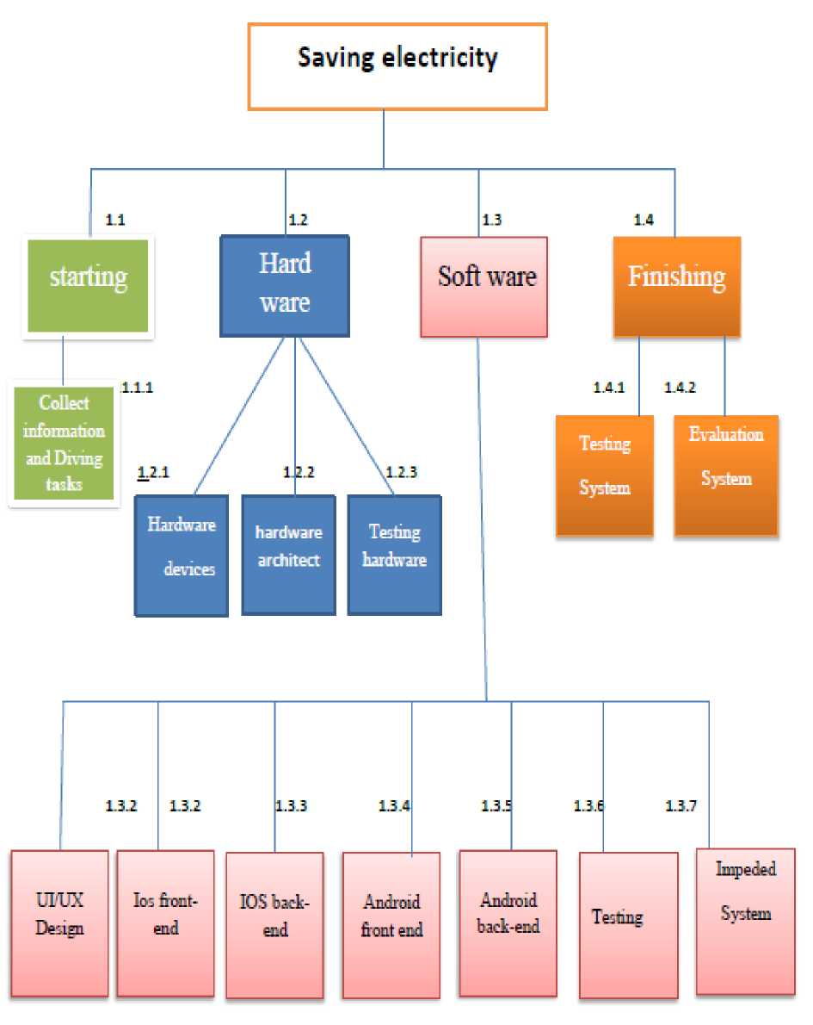
2) What are WBS of your project ?
2 | Page

Slide 4
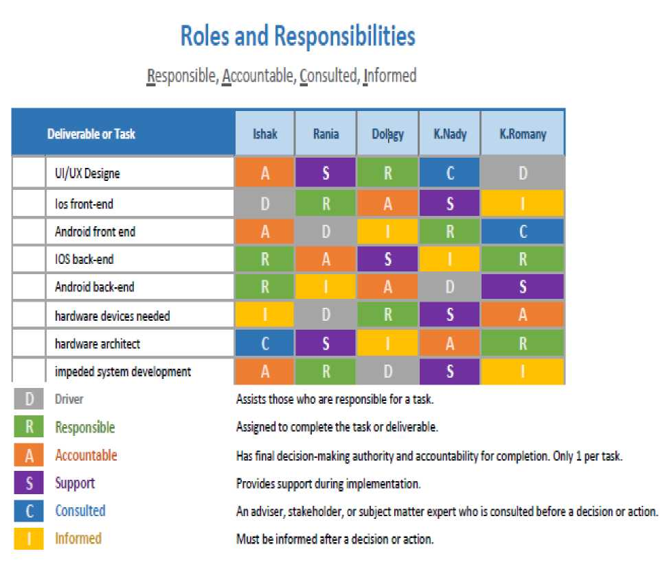
3)What is the responsible matrix ?
3 | Page

Slide 5
4)How your project is linked with company ?
How your project is linked with company:
The project is closely related to the electricity company, where the application works to save energy and electricity, and thus reduce costs for citizens ,and based on manufacturing systems and software engineering, and therefore the project is related to the company and its employees can perform the project tasks easily
Where the application can do that :
• the application in used to bring money by saving electricity and control electricity-power and function through Egypt.
4 | Page

Slide 6
• If you keep devices plugged in and running when they're not in use the result is an increase in electrical use and, consequently, a bump in the amount of greenhouse gases that enter the atmosphere.
• Leaving your laptop plugged in all the time will use nearly 300 kilowatt hours (kWh) of electricity each year and a desktop computer left to idle will use more than 600 kW of electricity annually.
• Even leaving your fully charged cellphone attached to its charger can waste almost 20 kWh a year it lead to rise the cost of Electricity bill and affect in your salary.
• Conserving energy is not just about saving on your electricity costs.
• The Organization for Economic Co-operation and Development warns that given the current trends, energy-related emissions will increase by 70 percent by 2050.

Slide 7
5) What is the project network of your program ?
Network information:
SAVING ELECTRICITY
Activity | Descriptions | Preceding activity | Activity Time(weeks)
A | Dividing tasks | None | 2
B | Ui/UX design | A | 3
C | IOS front | B | 5
D | IOS back | c: | 4
E | Android front | B | 4
F | Android back | E | 3
G | Hardware devices | A | 2
H | Hardware architect | G | 4
1 | Impeded system | H | 5
J | Testing system | l,F,D | 2
5 | Page

Slide 8
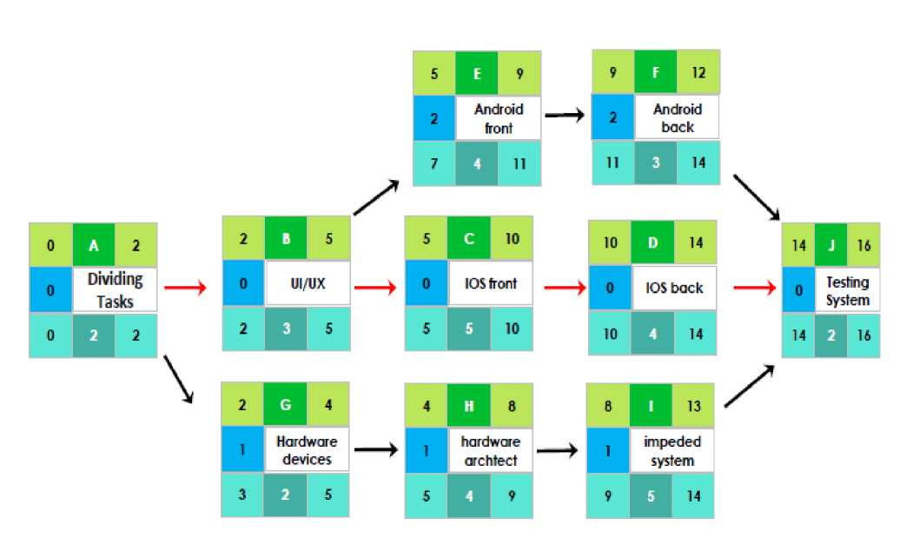
6)What is the critical path in your project ?
6 | Page

Slide 9
7) what is the risk in your project ?
1- Damage in the receivers.
2- Increase in the cost.
3- The lack of efficiency sufficient in the receiver or the teams.
4- Not to satisfy the users of product.
7 | Page

Slide 10
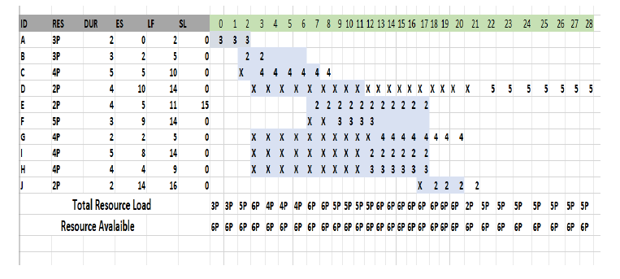
8) How to change the project network based on your number of programmer in your team and machines ?
8 | Page

Slide 11
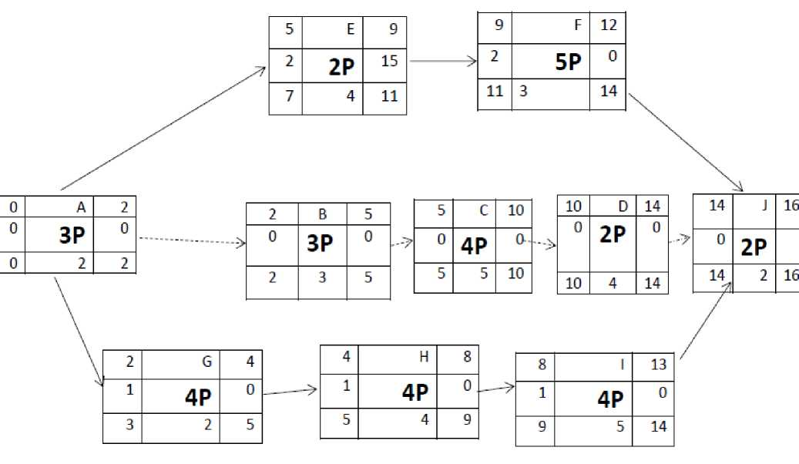

Slide 12
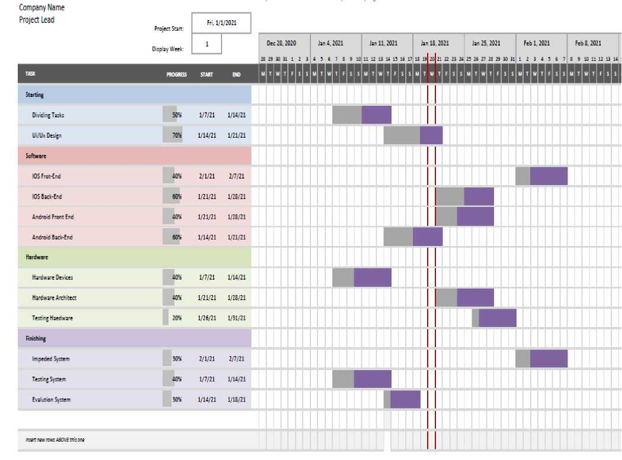
9) Draw final Gentt chart of your project ?
9 | Page

Slide 13
10) Estimate phase-time budget of your project ?
Activity | Budget Baseline | Budget Reserve | Project Budget
UI/UX design | 300,000 $ | 20,000 $ | 320,000 $
IOS Front | 300,000 $ | 8,000 $ | 308,000 $
IOS Back | 200,000 $ | 7,000 $ | 207,000 $
Android front | 250,000 $ | 6,000 $ | 256,000 $
Android back | 150,000 $ | 4,000 $ | 154,000 $
Hardware devices | 800,000 $ | 30,000 $ | 830,000 $
Hardware architect | 400,000 $ | 10,000 $ | 410,000 $
Impeded system | 300,000 $ | 25,000 $ | 325,000 $
Testing | 30,000 $ | 5,000 $ | 35,000 $
Total | 2730,000 $ | 115,000 $ | 2,845,000 $
10 | Page

Slide 14
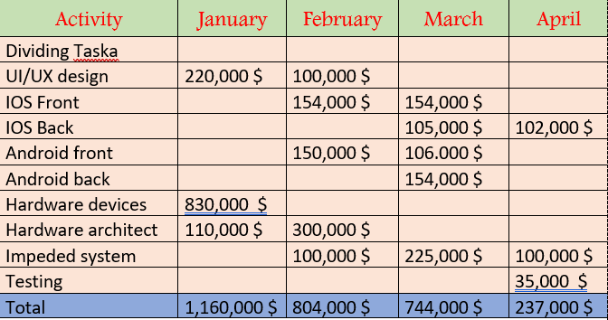
11) How can you monitor the project budget overtime ?

Slide 15
12) How to follow updates in GitHub ?
What is git and GitHub?
Git is Distributed Version Control System.
Git is free and open source.
We can use GitHub and Gitlab and GitBucket.
GitHub simplify using Git.
We can use Git without GitHub.
Git has GUI.
Why you must learn Git?
-Devs Contribute to The Same Project.
-You Can Revert Changes.
12 | Page

Slide 16
- You Can collaborate to fix issues.
- You Can Collaborate to Create New Features.
- You Can Solve Conflicts.
- You Can Organize Features.
The importance word will hear:
Repository - Branch - Commit - local repository - Remote repository -Clone -Push - pull - pull request.
Create new account in GitHub:

Slide 17
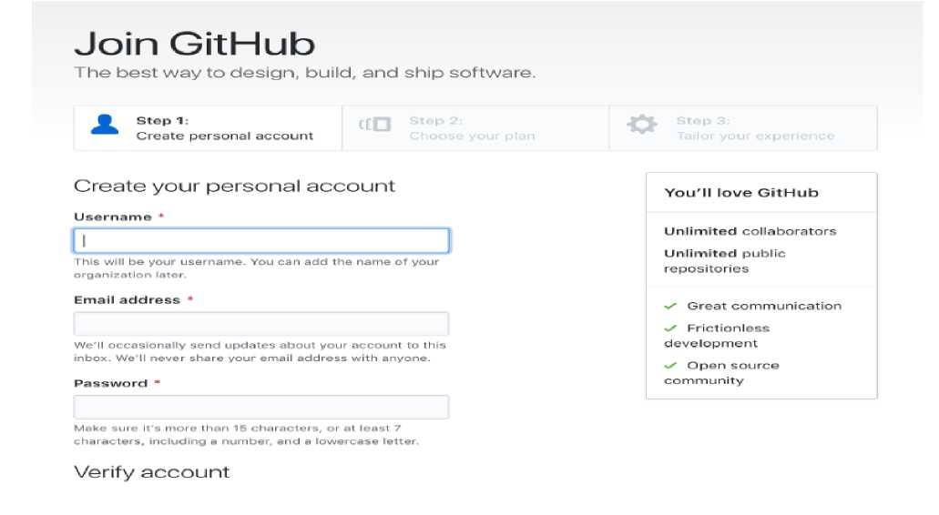
13 | Page

Slide 18
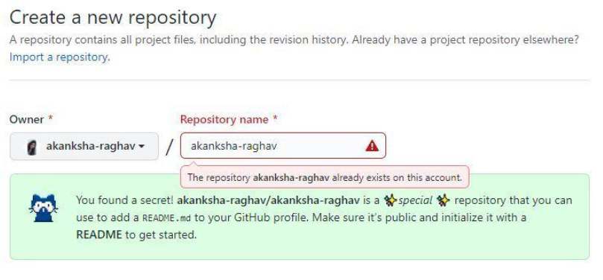
Create new repository in GitHub:

Slide 19
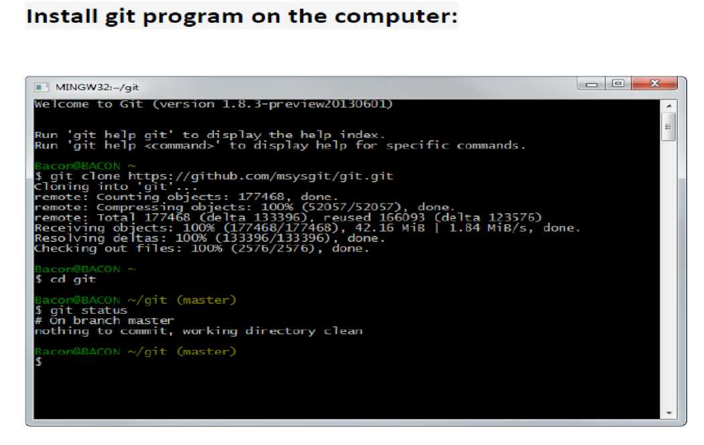
14 | Page

Slide 20
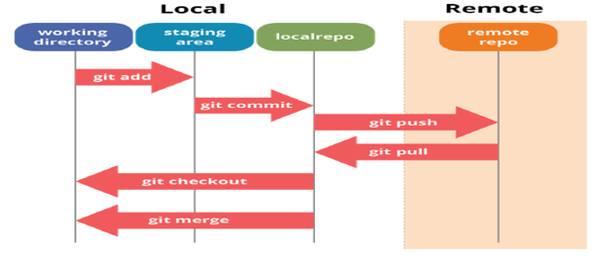
We are using some git commands to upload the project from the local repo on the computer to the remote repo on the GitHub:

Slide 21
The most commonly used get commands are:
git init : Initialized empty Git repository.
git clone : Clone a repository into a new directory.
git add(file name): Add file contents to the index.
git reset(file name) : Remove the file from the posting list while
keeping the new content intact. .
git status : List all new or changed files and are waiting to be committed.
git commit -m" " : Commit and save changes in posting list in copy past.
git config --global user.name"" : Set up the name to be included in the procedures for implementing or committing changes.
git config --global user.email"" : Set up the name to be included in the procedures for implementing or committing changes.
git remote : To see which remote servers you have configured. git branch: found in the repository.
git fetch: Retrieves objects and their related metadata from a remote repository.
git pull: Like git fetch, but also merges changes into a corresponding local branch.
15 | Page

Slide 22
git push: Transfers objects and their related metadata to a remote repository.
git show: To see more detail about a particular commit, use git show with a commit number.
git diff: To see the differences between the two revisions of file. git rm: to remove the file and stages the change. git rm -cached: removes the file from the index and leaves it in the working directory.
git mv: Change the file name and prepare to commit the changes.
touch: to creat new file on repository.
git branch (branch name): to creat new branch on the
repository.
git checkout (branch name): Change to a specific branch and update the current path.
git merge (branch name): Merging the current branch with another branch past.
git branch -d (branch name): removes the named branch from a repository.
cat (file name): create a new version of file with a few additional
lines in it and then commit the changes.
16 | Page

Slide 23
git stash: Caching of all tracked variable files.
git stash list: List all the temporary storage processes that have not been restored yet.
git stash apply: you can reapply the changes to your working
copy and keep them in your stash.
git stash show: The file is displayed in the stash file.
git stash save"" : To provide a bit more context, it’s good
practice to annotate your stashes with a description.
git stash pop: Temporarily restore the last changed files.
git remote add: To add a new remote Git repository as a short
name you can reference easily.
17 | Page

Slide 24
13) What are the patternes in your project ?
“Design Patterns” is a framework for thinking about software architecture suggested by Eric Gamma & altri by analogy to techniques used in Architecture (building houses).
In my project I had used Prototype :
Prototype => A fully initialized instance to be copied or cloned.
Singleton Pattern =>To share common data access throughout the application.
Observer Pattern => For Sending notification to subscribed users.
Iterator pattern => was used to browse through middle tier objects thus providing a tight encapsulation.
MVC Pattern => I had used at the presentation so model separated by controller.

